Slide 1
Network Model Architecture
Lecture 2

Slide 2
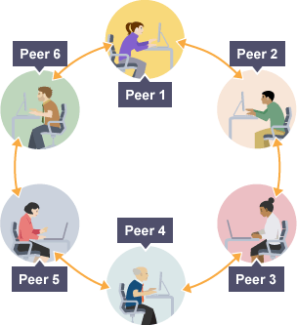
Network Models
A network is a combination of hardware and software that sends data from one location to another. The hardware consists of the physical equipment that carries signals from one point of the network to another. The software consists of instruction sets that make possible the services that we expect from a network.

Slide 3
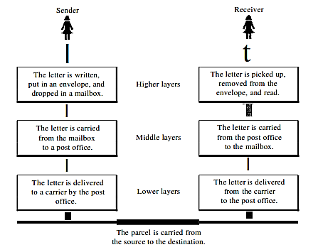
Layered Tasks
We use the concept of layers in our daily life. As an example, let us consider two friends who communicate through postal mail The process of sending a letter to a friend would be complex if there were no services available from the post office.
Fig: Tasks involved in sending a letter

Slide 4
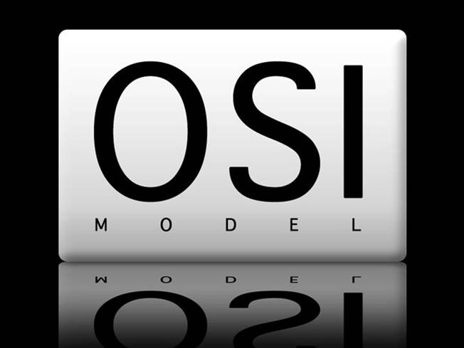

OSI Model
Established in 1947, the International Standards Organization (ISO) is a multinational body dedicated to worldwide agreement on international standards. An ISO standard that covers all aspects of network communications is the Open Systems Interconnection model (OSI) in late 1970s.
The purpose of the OSI model is to show how to facilitate communication between different systems without requiring changes to the logic of the underlying hard­ ware and software. The OSI model is not a protocol; it is a model for understanding and designing a network architecture that is flexible, robust, and interoperable.

Slide 5
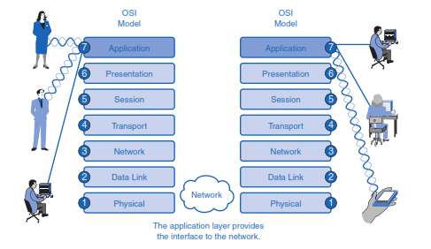
OSI Model cont.

Slide 6
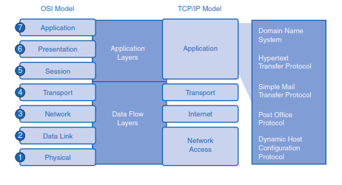
OSI & TCP/IP Model

Slide 7
Application Layer
This section introduces two important concepts:
1. Application layer: The application layer of the OSI model provides the first step of getting data onto the network.
2. Application software: Applications are the software programs used by people to communicate over the network. Examples of application software, including HTTP, FTP, e-mail, and others, are used to explain the differences between these two concepts.

Slide 8
Presentation Layer
The presentation layer has three primary functions:
Coding and conversion of application layer data to ensure that data from the source device can be interpreted by the appropriate application on the destination device
Compression of the data in a manner that can be decompressed by the destination device
Encryption of the data for transmission and decryption of data upon receipt by the destination

Slide 9
Session Layer
Functions at the session layer create and maintain dialogs between source and destination applications. The session layer handles the exchange of information to initiate dialogs and keep them active, and to restart sessions that are disrupted or idle for a long period of time.
This layer support the session by –
Establishing Connections
Maintaining Connections
Synchronizing Connections
Controlling Dialogues
Terminating Connections

Slide 10
Transport Layer
The Transport layer provides for the segmentation of data and the control necessary to reassemble these pieces into the various communication streams. Its primary responsibilities to accomplish this are:
Multiplexing and Demultiplexing
Segmenting data and managing each piece
Reassembling the segments into streams of application data
Identifying the different applications (HTTP 80, FTP 20,21)

Slide 11
Network Layer
The Network layer, or OSI Layer 3, provides services to exchange the individual pieces of data over the network between identified end devices. To accomplish this end-to-end transport, Layer 3 uses following basic processes:
Logical Addressing
Encapsulation
Routing
Decapsulation
Error handling & Diagnostics

Slide 12
Data Link Layer
The data link layer transforms the physical layer, a raw transmission facility, to a reli­able link. It makes the physical layer appear error-free to the upper layer (network layer). Other responsibilities of the data link layer include the following:
Framing: The data link layer divides the stream of bits received from the network layer into manageable data units called frames.
Physical addressing: If frames are to be distributed to different systems on the network, the data link layer adds a header to the frame to define the sender and/or Receiver of the frame. If the frame is intended for a system outside the sender's network, the receiver address is the address of the device that connects the network to the next one.
Flow control: If the rate at which the data are absorbed by the receiver is less than the rate at which data are produced in the sender, the data link layer imposes a Flow control mechanism to avoid overwhelming the receiver.

Slide 13
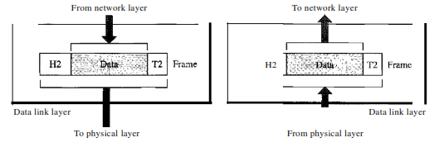
Data Link Layer cont.
4. Error control. The data link layer adds reliability to the physical layer by adding mechanisms to detect and retransmit damaged or lost frames. It also uses a mecha­nism to recognize duplicate frames. Error control is normally achieved through a trailer added to the end of the frame.
5. Access control. When two or more devices are connected to the same link, data link layer protocols are necessary to determine which device has control over the link at any given time.

Slide 14
Physical Layer
The OSI Physical layer provides the means to transport across the network media the bits that make up a Data Link layer frame. This layer accepts a complete frame from the Data Link layer and encodes it as a series of signals that are transmitted onto the local media. The encoded bits that comprise a frame are received by either an end device or an intermediate device.
The delivery of frames across the local media requires the following Physical layer elements:
The physical media and associated connectors
A representation of bits on the media
Encoding of data and control information
Transmitter and receiver circuitry on the network devices

Slide 15
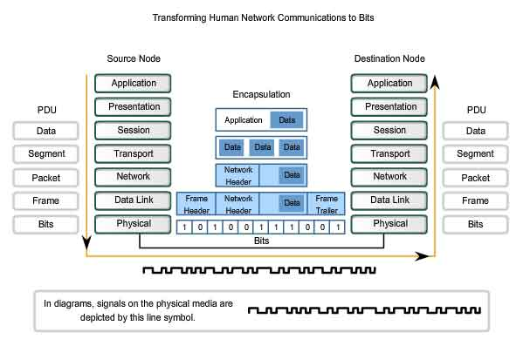
Encapsulation

Slide 16
Switching
A network is a set of connected devices. Whenever there are multiple devices, there is always a problem of how to connect them to make one-to-one communication possible. One solution is to make a point-to-point connection between each pair of devices (a mesh topology) or between a central device and every other device (a star topology).
Problem -
Impractical and wasteful when applied to very large networks.
The number and length of the links require too much infrastructure
The majority of those links would be idle most of the time.

Slide 17
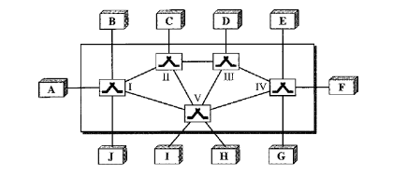
Switching - solution
A better solution is switching!!
A switched network consists of a series of interlinked nodes, called switches.
Switches are devices capable of creating temporary connections between two or more devices linked to the switch.
In a switched network, some of these nodes are connected to the end systems (computers or telephones, for example). Others are used only for routing.
Fig: Switched network
The end systems (communicating devices) are labeled A, B, C, D, and so on, and the switches are labeled I, II, III, IV, and V. Each switch is connected to multiple links.

Slide 18
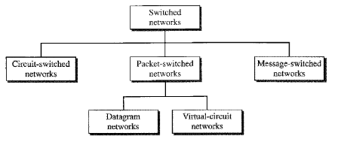
Switching - methods
Today's networks can be divided into three broad categories:
Circuit-switched networks,
Packet-switched networks,
Message-switched.

Slide 19
Circuit Switching Principle
Circuit switching is a technique that directly connects the sender and the receiver in an unbroken path. There is a dedicated communication path between two stations (end-to-end). The path is a connected sequence of links between network nodes.
Communication via circuit switching has three phases:
Circuit establishment (link by link)
Routing & resource allocation (FDM or TDM)
Data transfer
Circuit disconnect
De-allocate the dedicated resources
With this type of switching technique, once a connection is established, a dedicated path exists between both ends until the connection is terminated.
Telephone switching equipment, for example, establishes a path that connects the caller's telephone to the receiver's telephone by making a physical connection.

Slide 20
Circuit Switching Principle
Advantages:
The communication channel (once established) is dedicated.
Disadvantages:
Possible long wait to establish a connection, (10 seconds, more on long- distance or international calls.) during which no data can be transmitted.
More expensive than any other switching techniques, because a dedicated path is required for each connection.
Inefficient use of the communication channel, because the channel is not used when the connected systems are not using it.

Slide 21
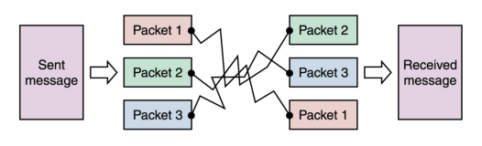
Packet Switching Principle
In a packet-switched network, the message divided into packets of fixed or variable size. The size of the packet is determined by the net­work and the governing protocol.
In packet switching, there is no resource allocation for a packet. This means that there is no reserved bandwidth on the links, and there is no scheduled processing time for each packet.
Resources are allocated on demand. The allocation is done on a first­ come, first-served basis.
When a switch receives a packet, no matter what is the source or destination, the packet must wait if there are other packets being processed.
Fig: Packet Switching

Slide 22
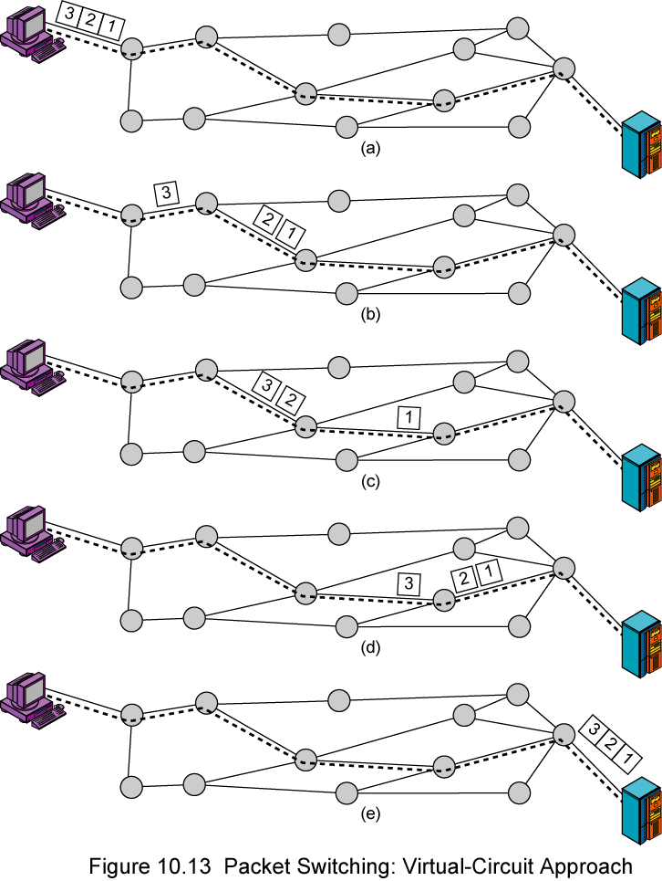
Virtual Circuit Switching Principle
A route between stations is set up prior to data transfer.
All the data packets then follow the same route.
But there is no dedicated resources reserved for the virtual circuit! Packets need to be stored-and-forwarded.

Slide 23
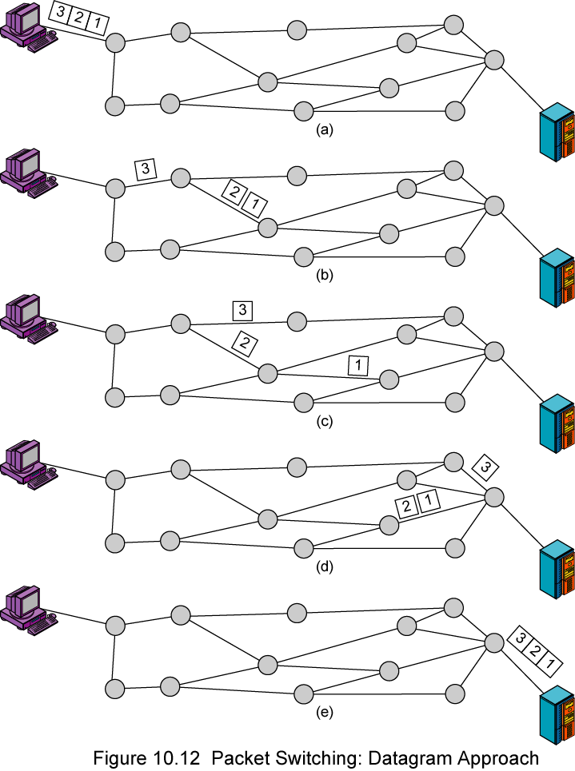
Datagram Network
Each packet is treated independently, with no reference to packets that have gone before.
- Each node chooses the next node on a packet’s path.
Packets can take any possible route.
Packets may arrive at the receiver out of order.
Packets may go missing.

Slide 24
Advantages of packet switching
Advantages:
Packet switching is cost effective, because switching devices do not need massive amount of secondary storage.
Packet switching offers improved delay characteristics, because there are no long messages in the queue (maximum packet size is fixed).
Packet can be rerouted if there is any problem, such as, busy or disabled links.
The advantage of packet switching is that many network users can share the same channel at the same time. Packet switching can maximize link efficiency by making optimal use of link bandwidth.

Slide 25
Disadvantages of packet switching
Disadvantages:
Protocols for packet switching are typically more complex.
It can add some initial costs in implementation.
If packet is lost, sender needs to retransmit the data.
Another disadvantage is that packet-switched systems still can’t deliver the same quality as dedicated circuits in applications requiring very little delay - like voice conversations or moving images.

Slide 26
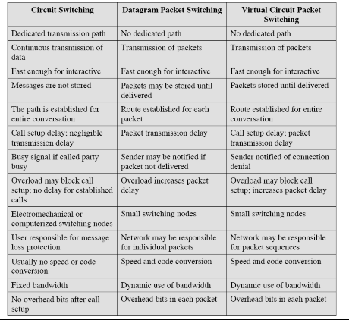
Comparison of Switching Techniques

Slide 27
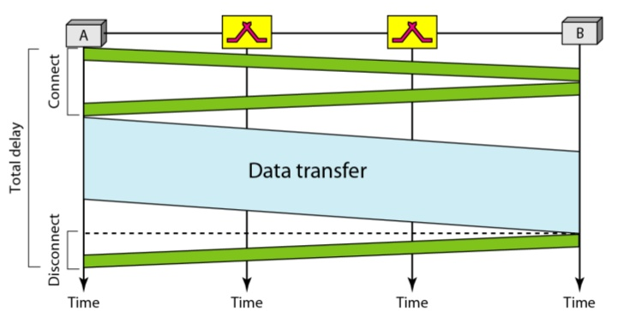
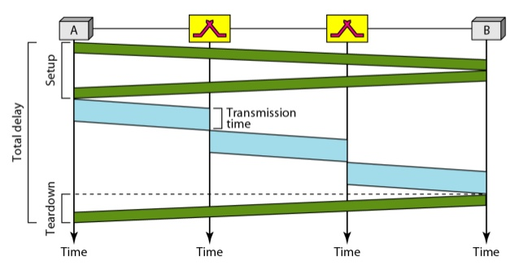
Delay in Different Switching
Fig: Circuit Switch delay
Fig: Packet Switch delay

Slide 28
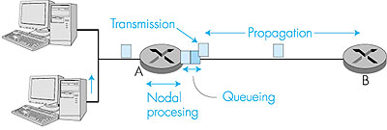
Types of Delay
There are four kinds of delay –
Processing Delay
Queuing Delay
Transmission Delay
Propagation Delay
Total Delay:
d_{nodal} = d_{proc} + d_{queue} + d_{trans} + d_{prop}
Processing Delay: The time required to examine the packet's header and determine where to direct
the packet is part of the processing delay.
2. Queuing Delay: At the queue, the packet experiences a queuing delay as it waits to be transmitted
onto the link

Slide 29
Types of Delay
Transmission Delay: This is the amount of time required to transmit all of the packet's bits into the link. Transmission delays are typically on the order of microseconds or less in practice.
L: packet length (bits)
R: link bandwidth (bps)
dtrans = L/R
4. Propagation Delay: is the time it takes a bit to propagate from one router to the next; it is a function
of the distance between the two routers, but has nothing to do with the packet's length or the
transmission rate of the link.
d: length of physical link
S: propagation speed in medium (~2x108 m/sec) !
dprop d = d/s

Slide 30
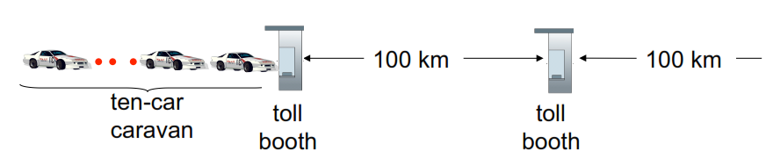
Caravan analogy
cars “propagate” at 100 km/hr
toll booth takes 12 sec to
service car (bit transmission time)
car~bit; caravan ~ packet
Q: How long until caravan is lined up before 2nd toll booth?
time to “push” entire caravan through toll
booth onto highway = 12*10 = 120 sec
time for last car to propagate from 1st to
2nd toll both: 100km/(100km/hr)= 1 hr
The time required for the toll booth to push the entire caravan onto the highway is 10/(5 cars/minute) = 2 minutes.
A: 62 minutes

